Slide 1
Status Sheet Overview
“The Post Report Card”
Greg Brannan
Texas VFW Mentorship Chairman
VFW Post 12205, Bulverde TX

Slide 2
Agenda
Location
Navigating through the X’s, P’s and S's on the entries
Membership Goals
Audits
District Requirements
Insurance
All State / Community Service
VPRs

Slide 3
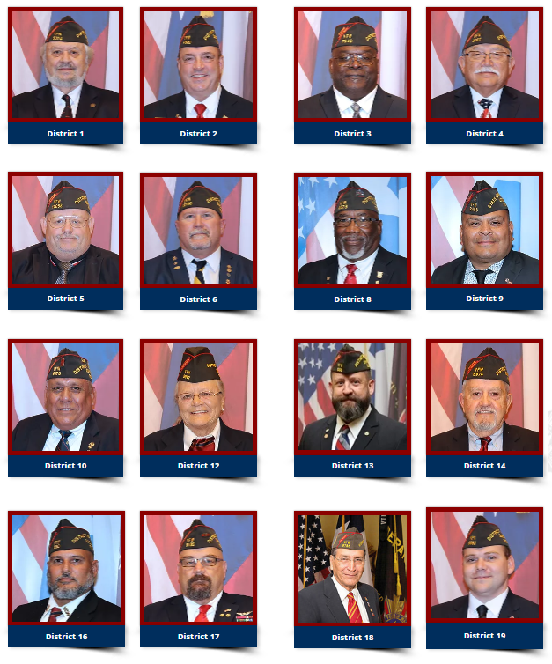
Location
https://www.texasvfw.org/status-sheets
Find and click on your District Commander (click on their picture)
NOTE: The page currently reflects 2021 Commanders

Slide 4
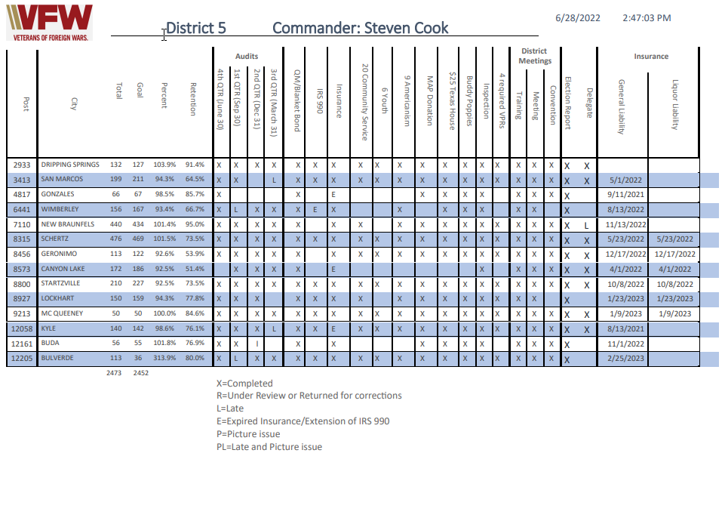
Navigating through the X’s, P’s on blanks
Membership Goal for the year 2022-2023
Qrtly Audits
Are you current?
Mandatory Items in the SOP
Mandatory District Mtg Attendance
Find your Post
Post Insurance

Slide 5
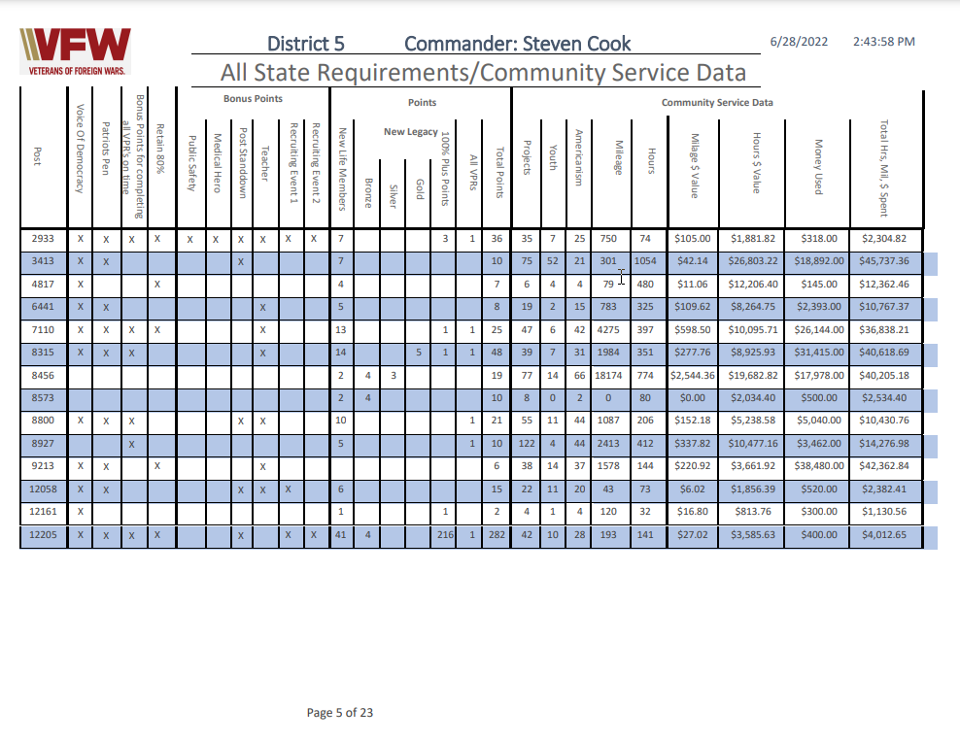
Navigating the Status Sheet
Participation Points for Commanders Programs
All about the All-State points (Refer to the SOP)
Community Service Data

Slide 6
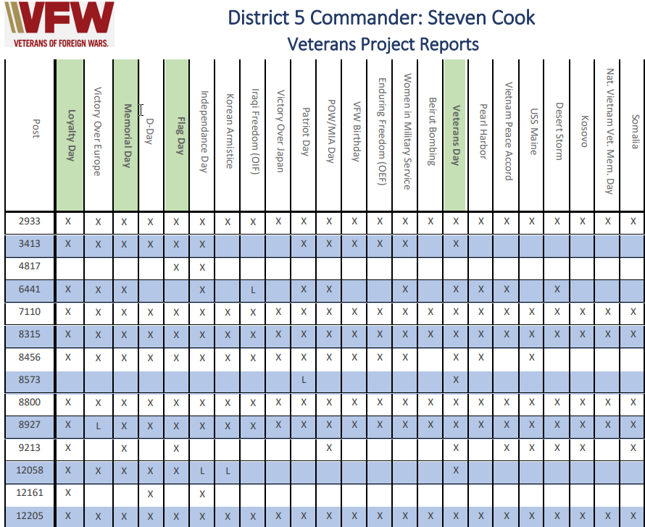
Navigating the Status Sheet
Veterans Participation Reports (4 Mandatory)

Slide 7
Now A Word From Our Stats Guy
Do’s
Don’ts

Slide 8
Contact us with any questions!
Greg Brannan
Texas VFW Mentorship Chairman
VFW Post 12205, Bulverde TX

